Slide 1
LOCALL
TEAM MEMBERS:
ASHMIYA VIJAYACHANDRAN
PRANAV PRAKASH
THEJUS THOMSON
SHASHIKAR ANTHONI RAJ

Slide 2
OVERVIEW
locAll, with its user-friendly interface and robust features, serves as the ultimate hub for fostering connections within local communities. This innovative web application transforms the way neighbors engage with their surroundings, offering a centralized platform for events, commerce, and community initiatives—all meticulously tailored to your specific location. From a location-centric experience based on your zipcode to verified user publishing for events and marketplace listings, locAll ensures a secure and reliable space for community members. Whether you're organizing local events, participating in the dynamic marketplace, or staying updated with real-time weather information, locAll brings the essence of community living to your fingertips. Join locAll today, embark on a journey of vibrant local interactions, and contribute to making every neighborhood an even better place.

Slide 3












TECH STACK
Backend Stack Frontend Stack

Slide 4
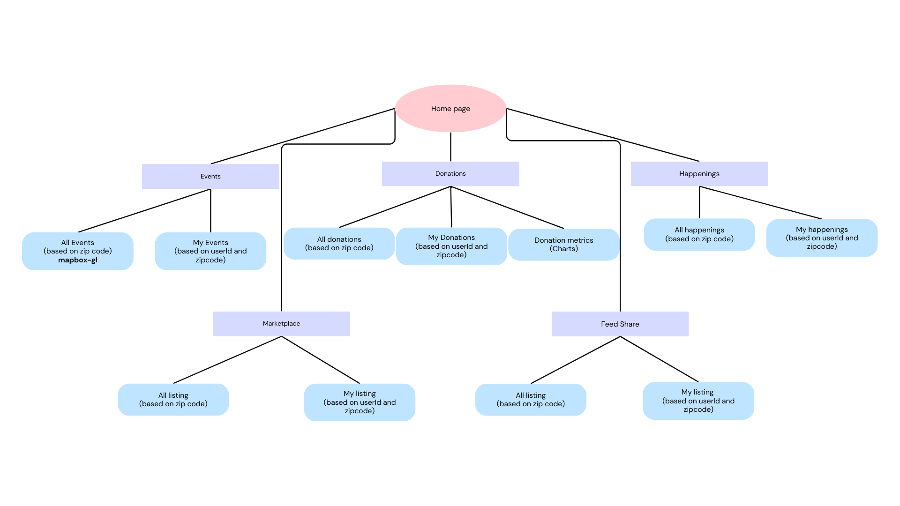
NAVIGATION

Slide 5
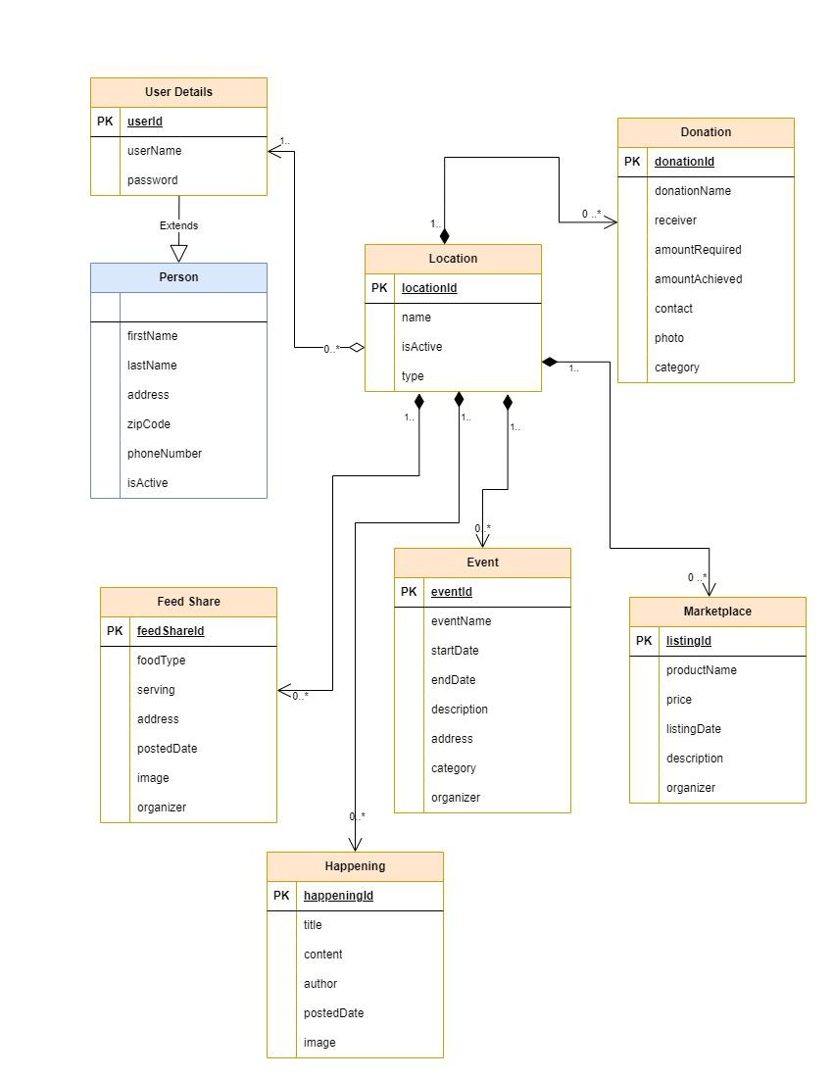
SCHEMA

Slide 6
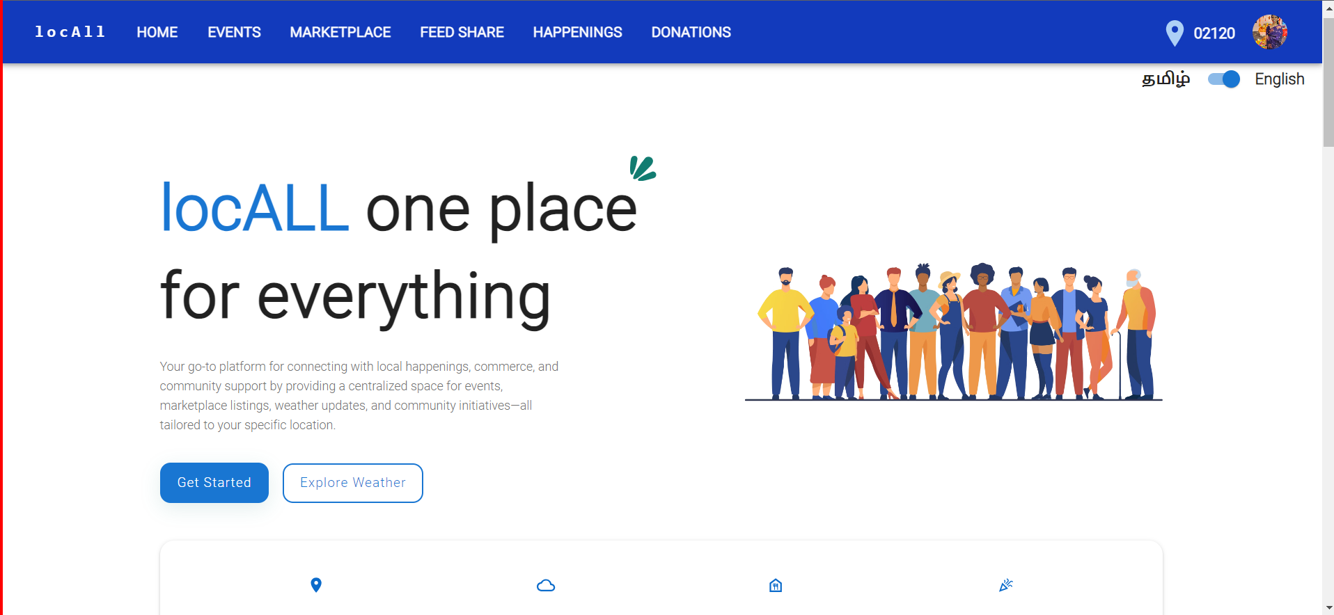
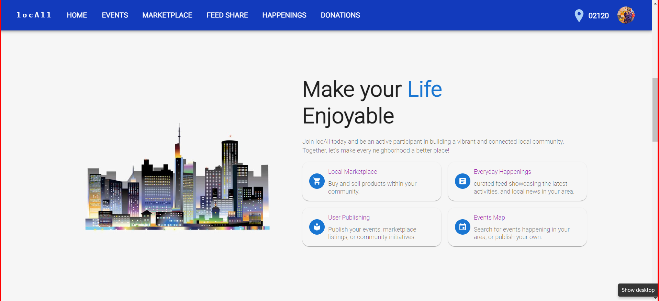
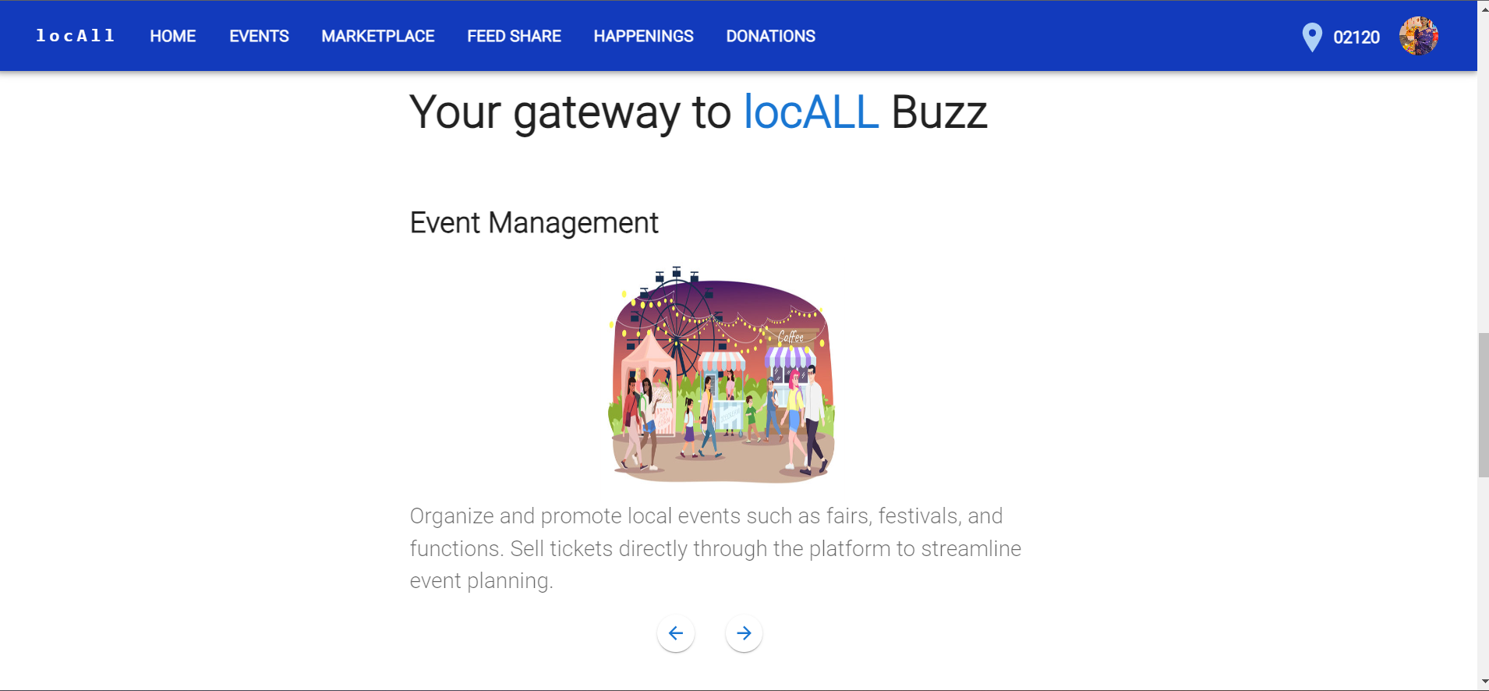
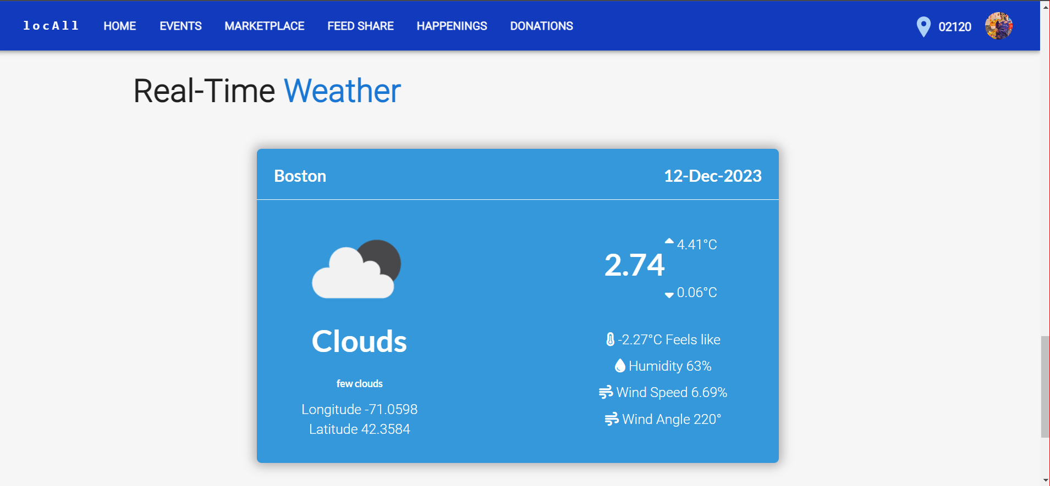
HOME PAGE

Slide 7
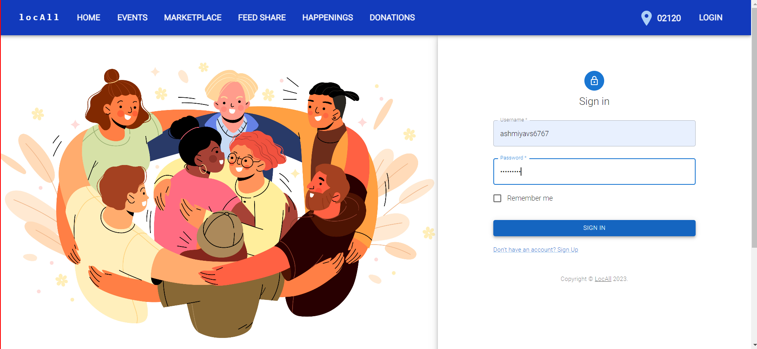
LOGIN

Slide 8
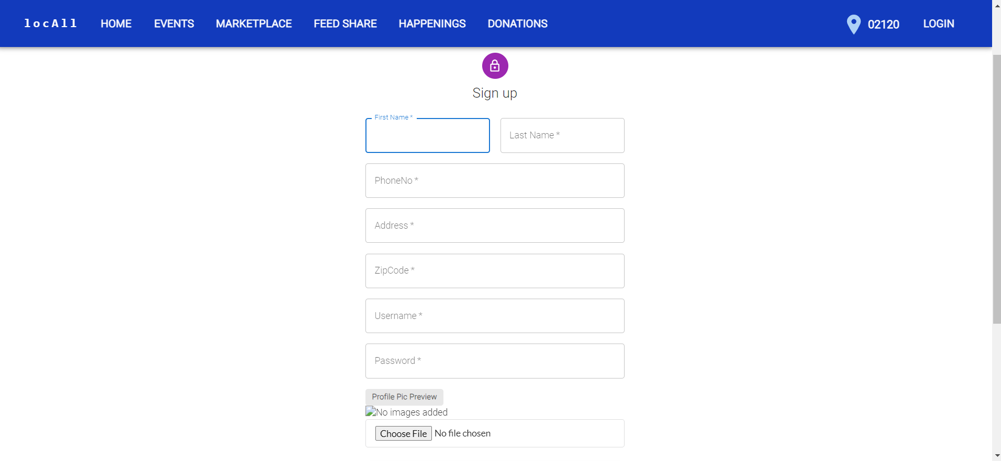
REGISTER

Slide 9
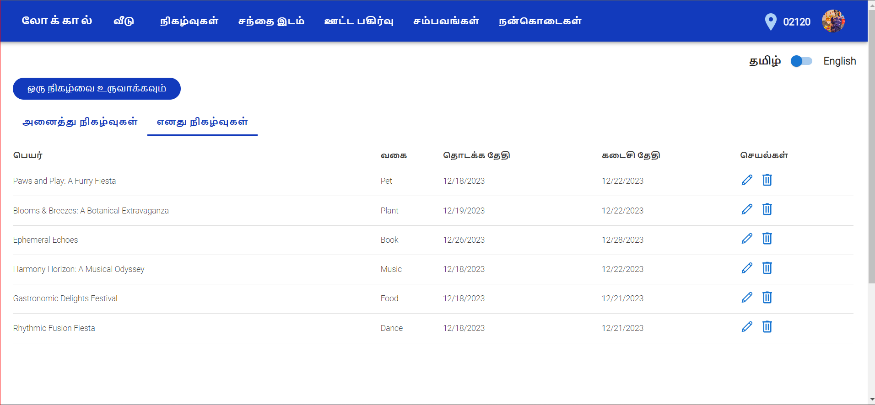
INTERNATIONALIZATION

Slide 10
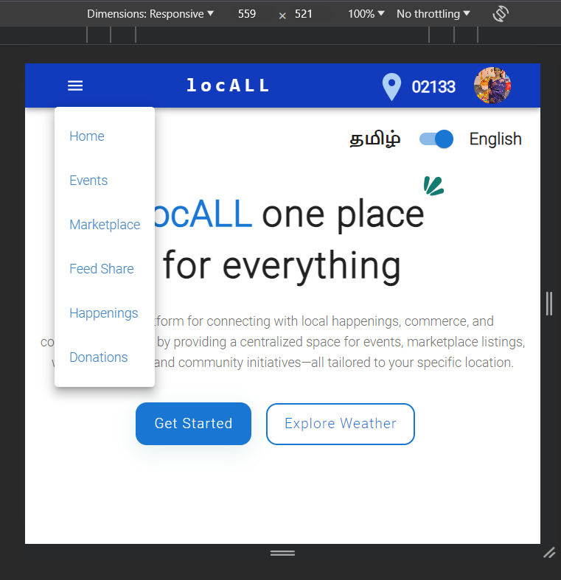
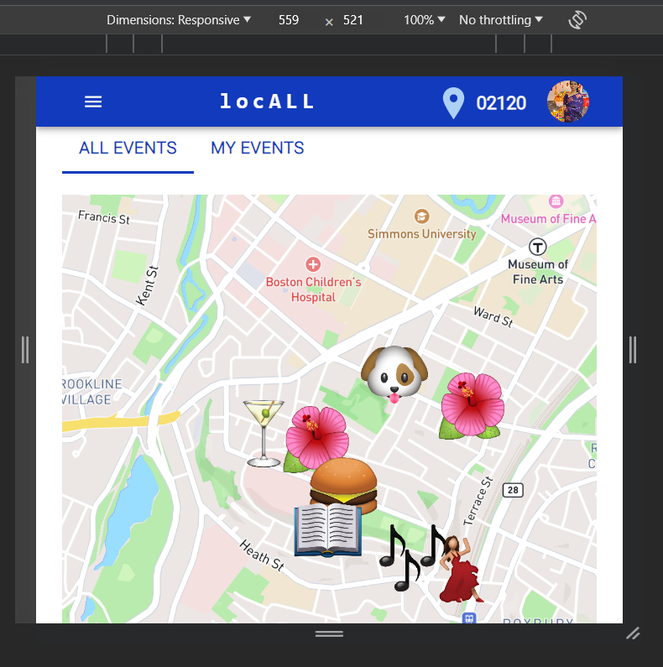
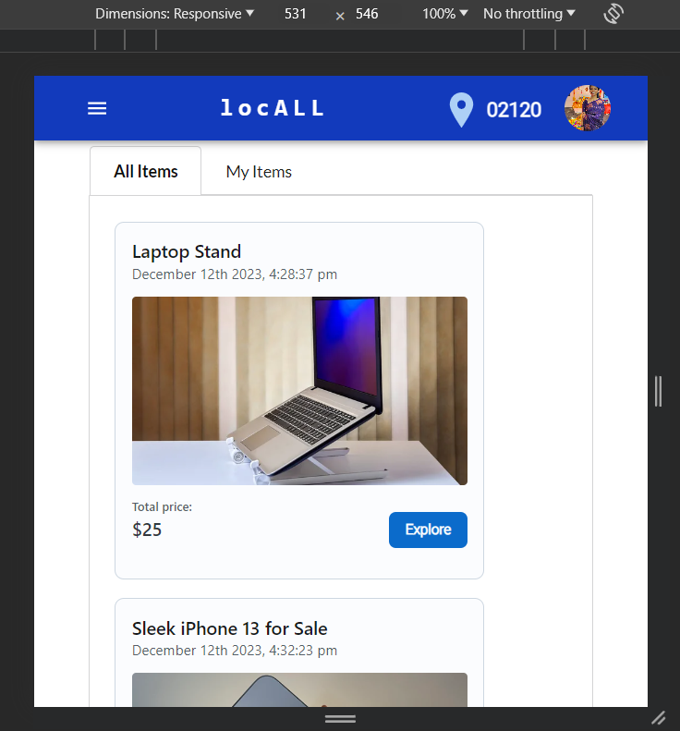
PROGRESSIVE WEB APP

Slide 11
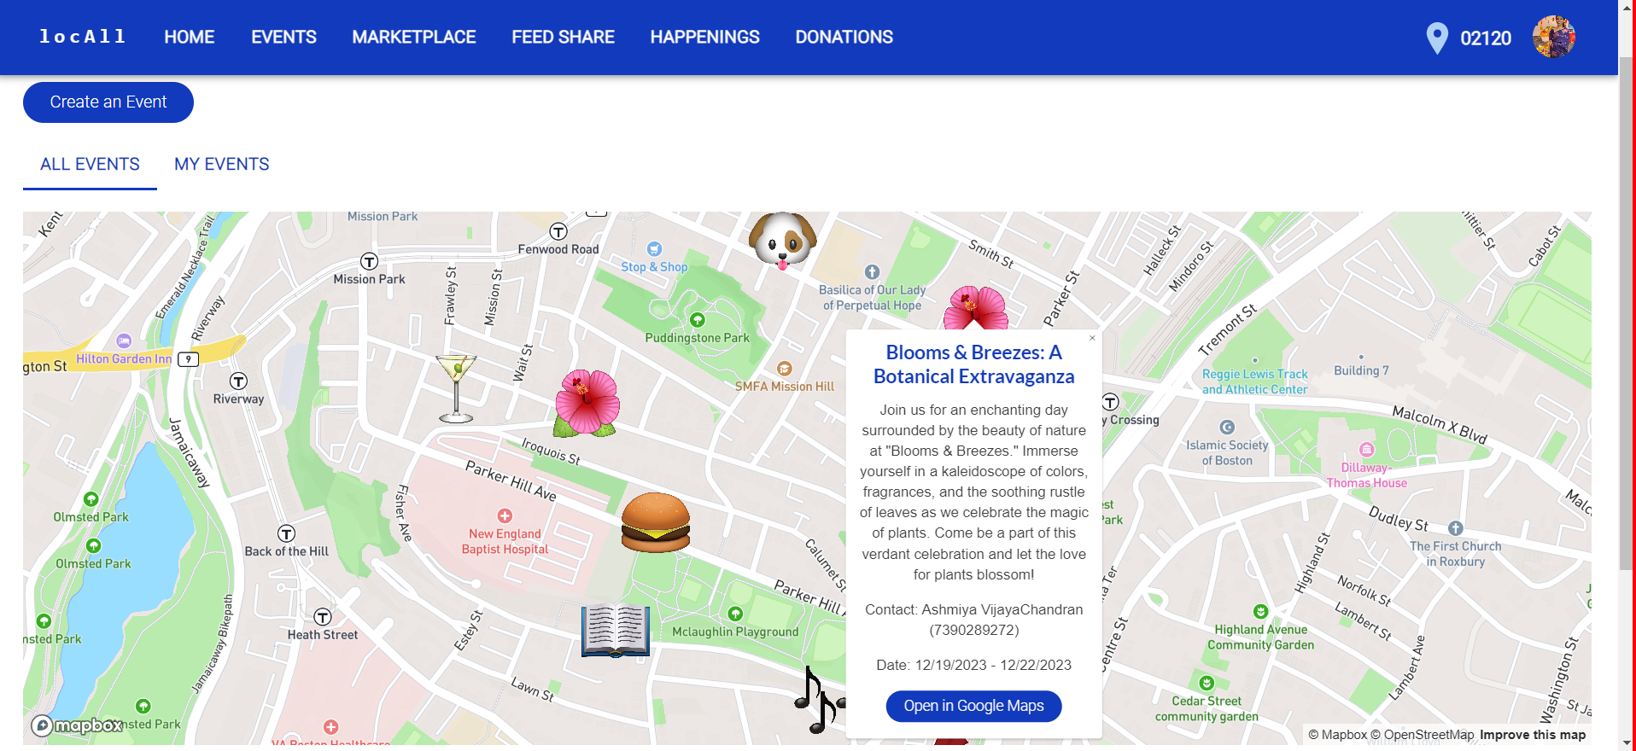
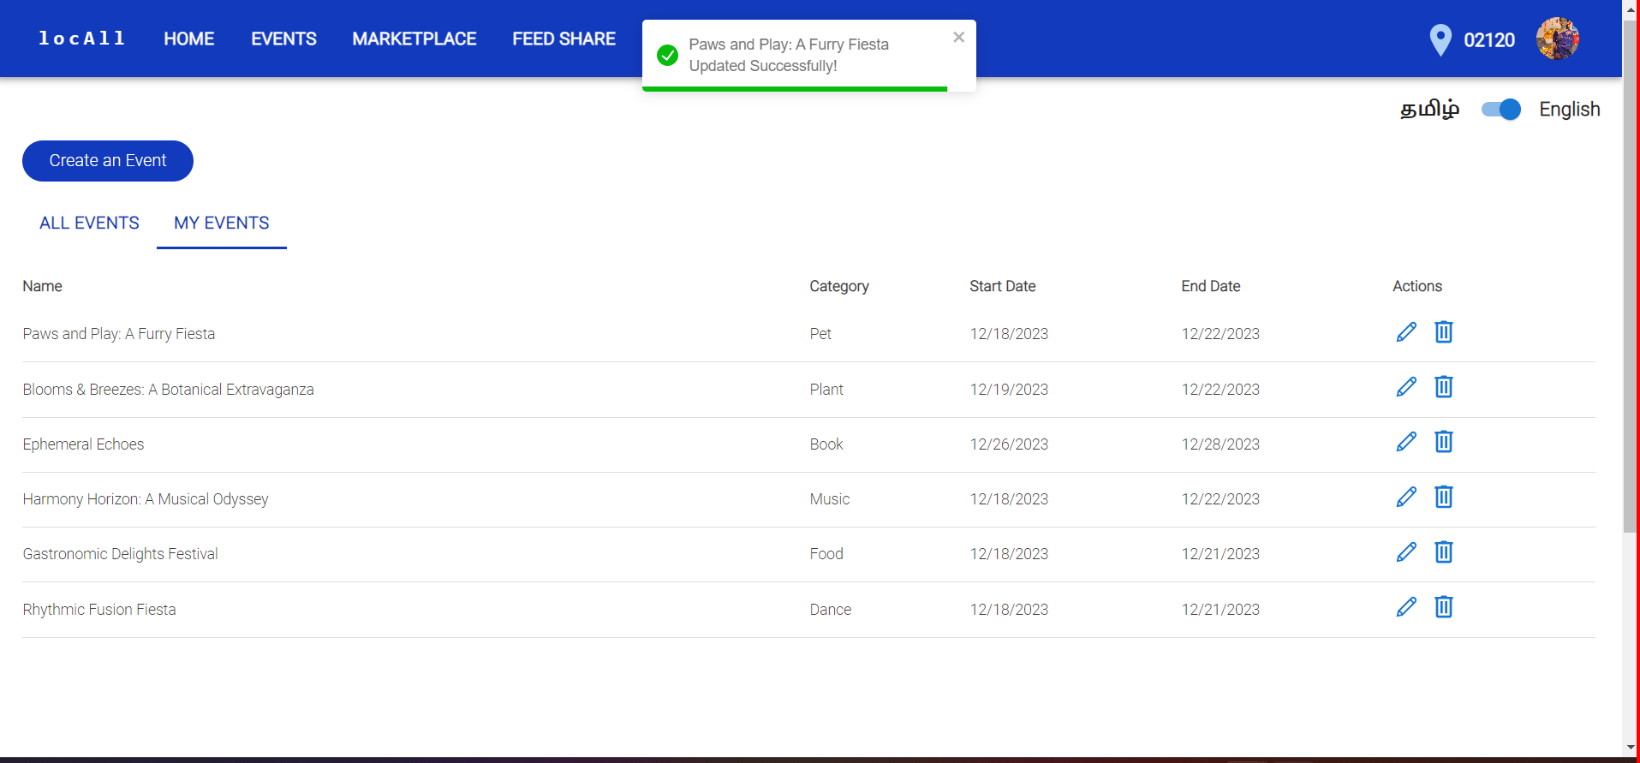
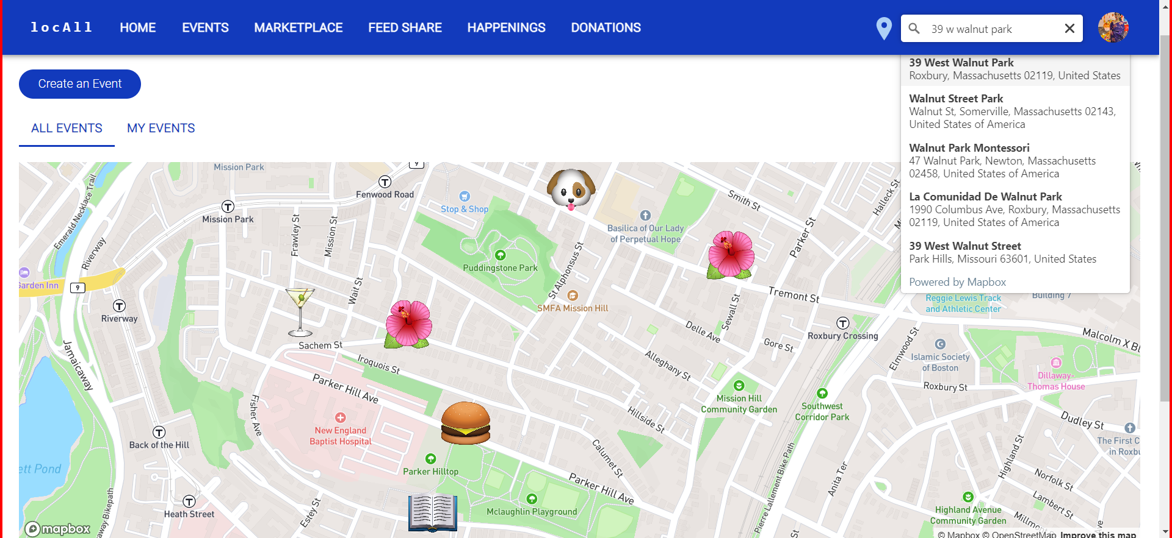
EVENTS

Slide 12
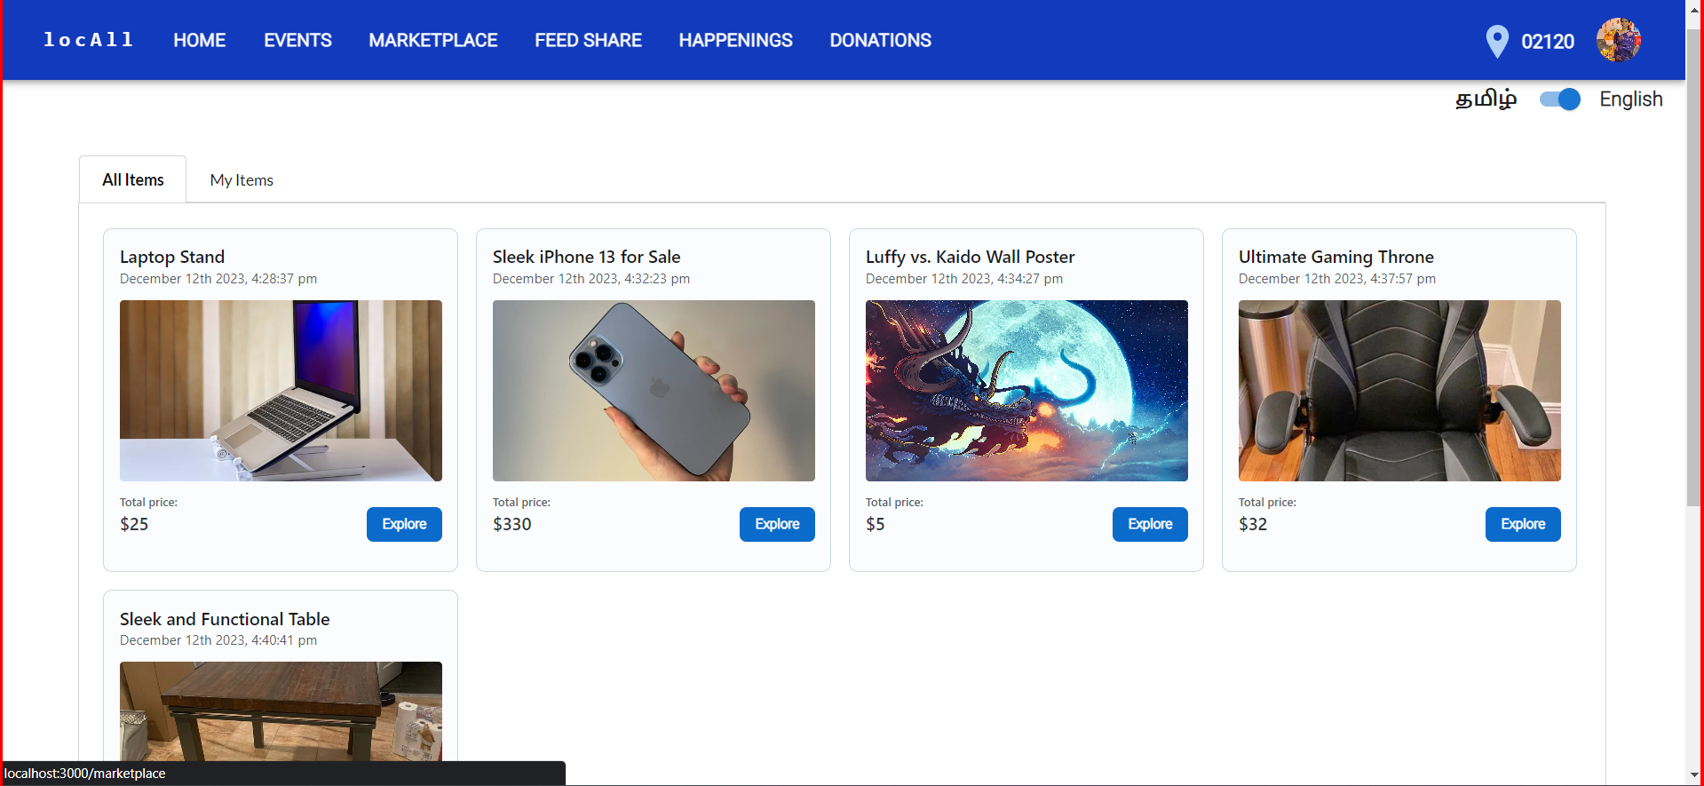
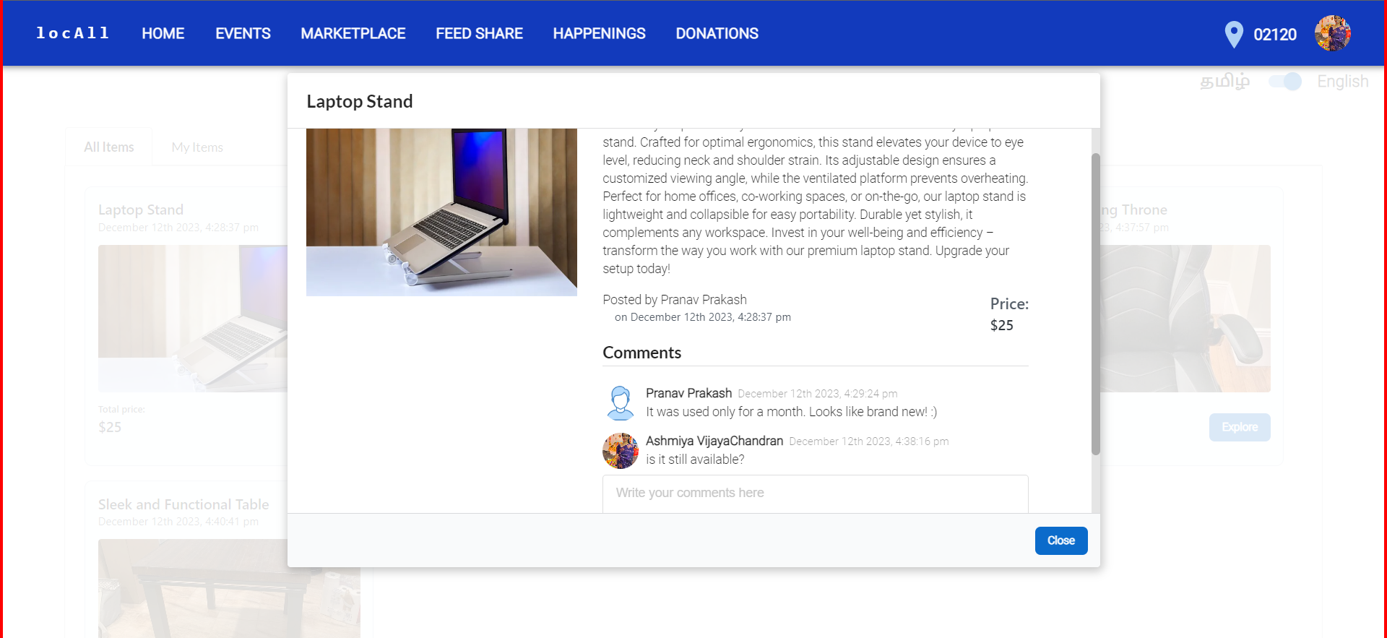
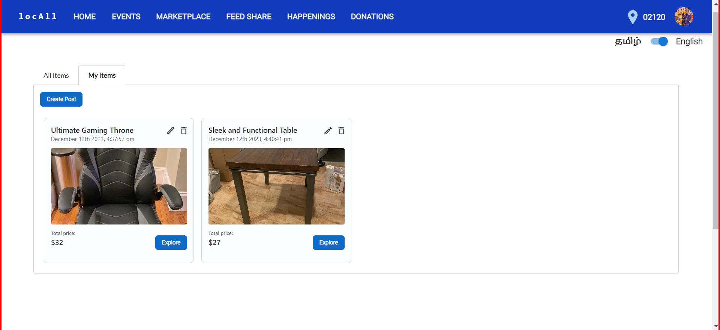
MARKETPLACE

Slide 13
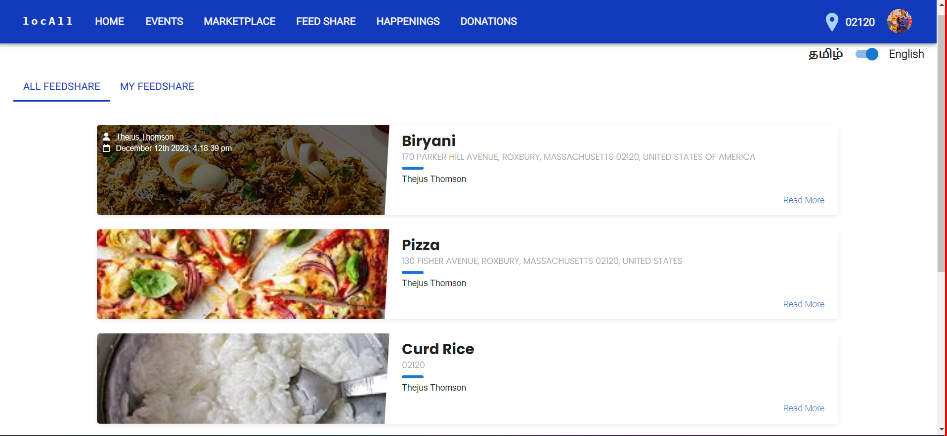
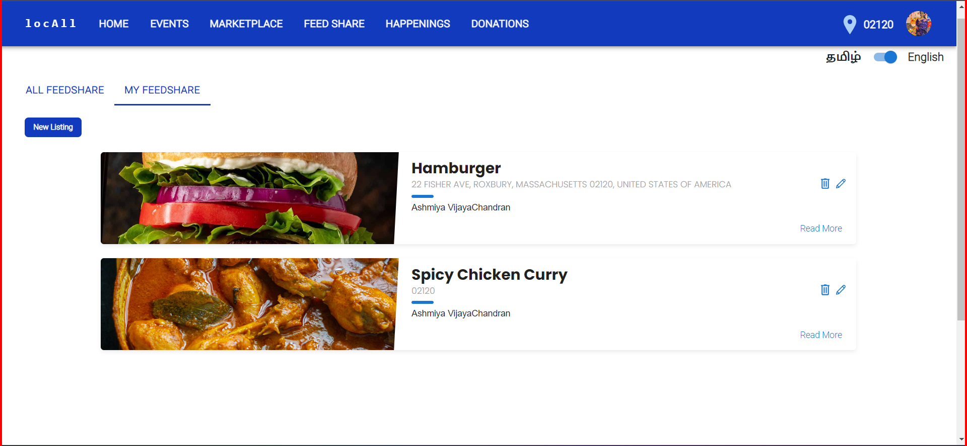
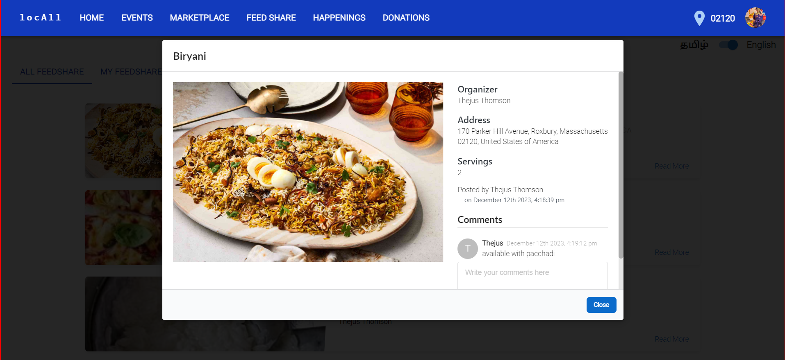
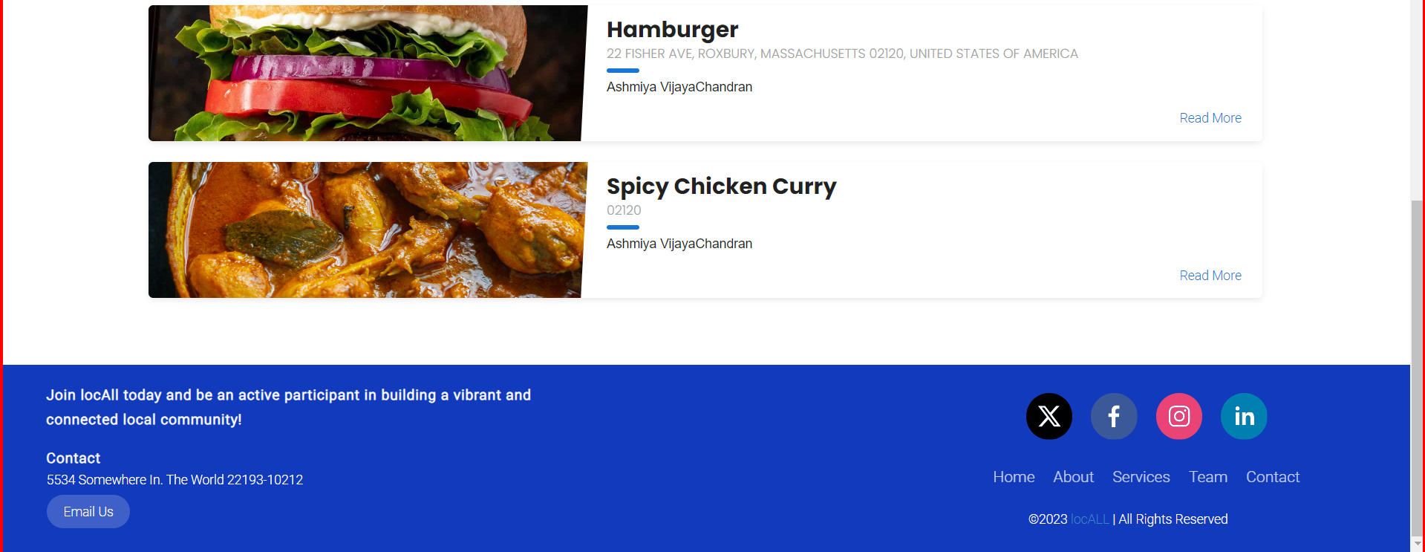
FEEDSHARE

Slide 14
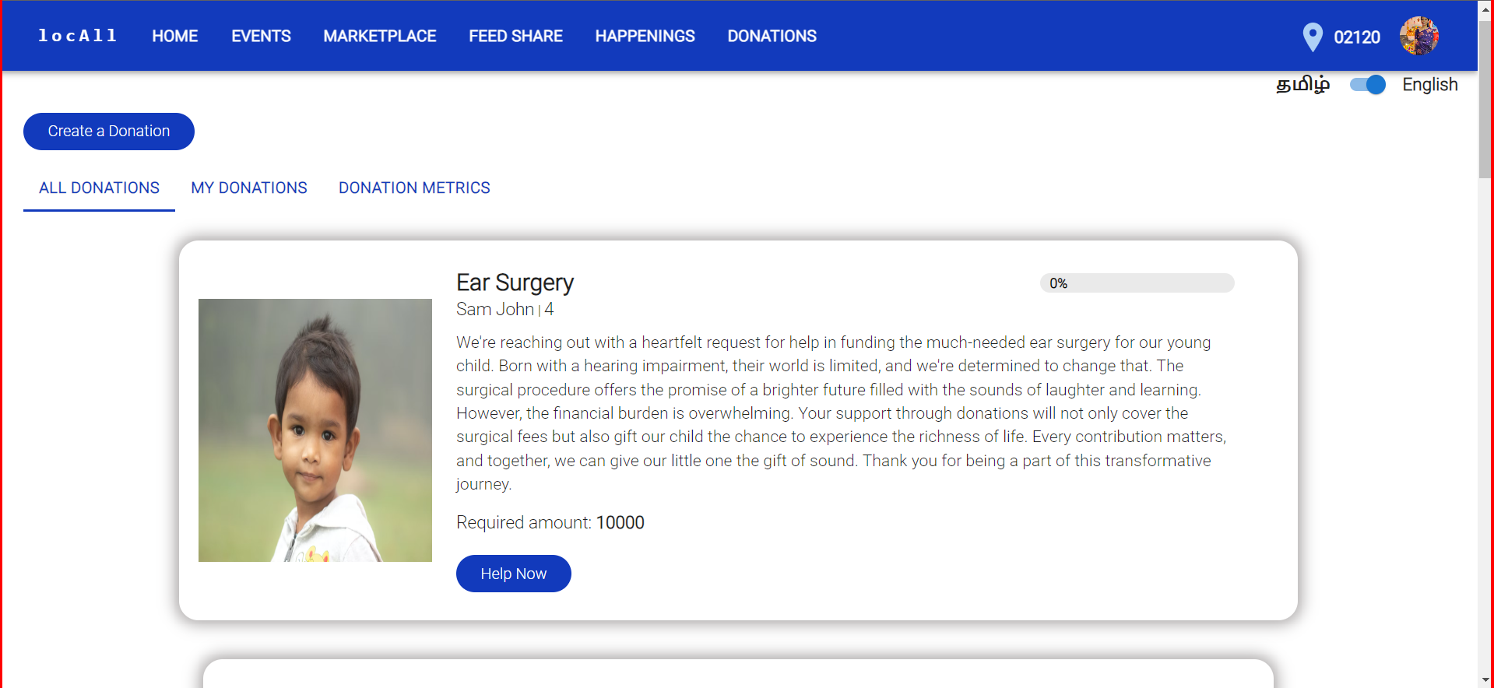
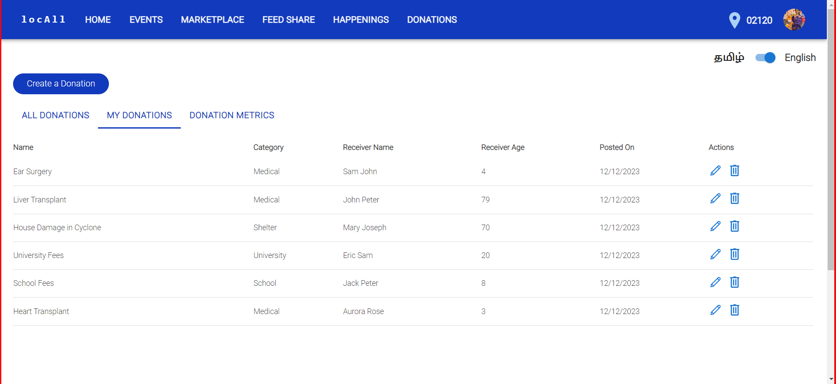
DONATIONS

Slide 15
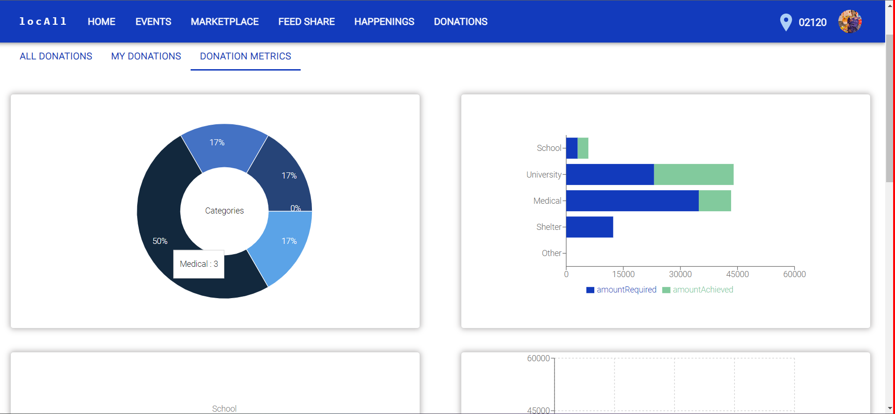
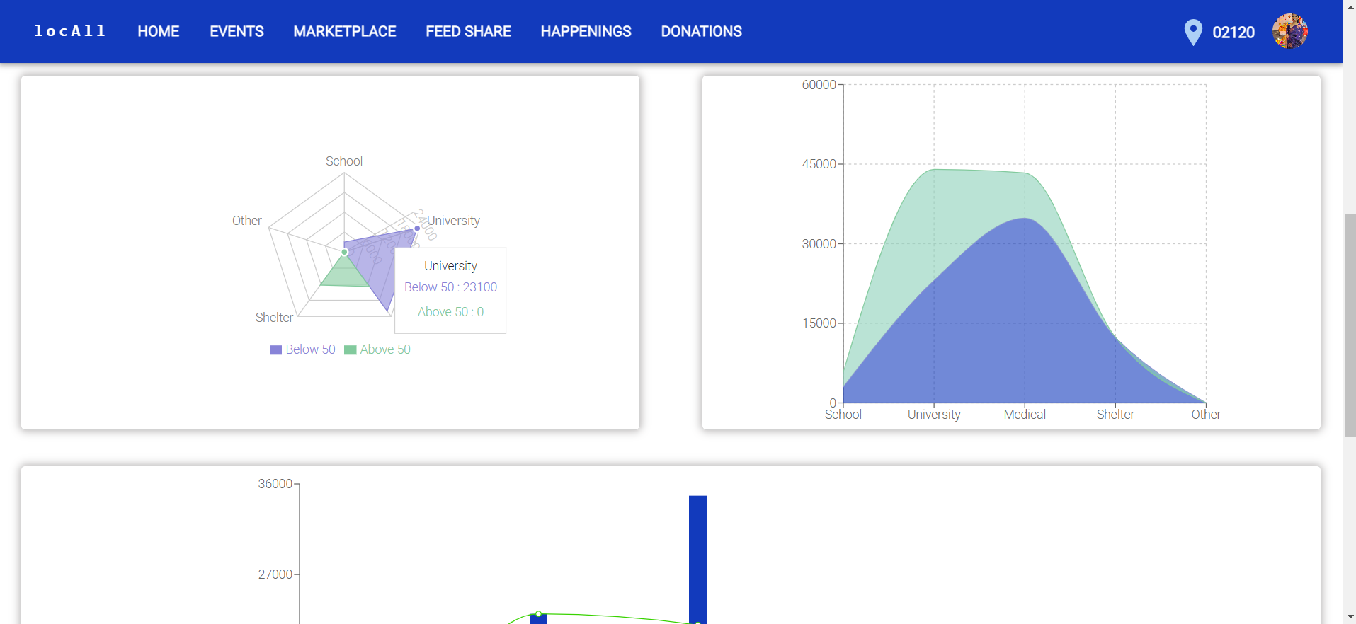
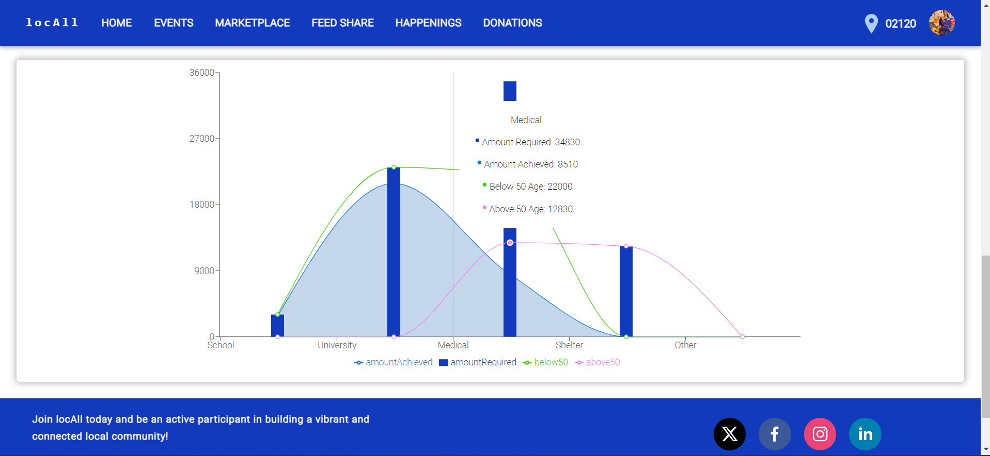
DONATIONS METRICS

Slide 16
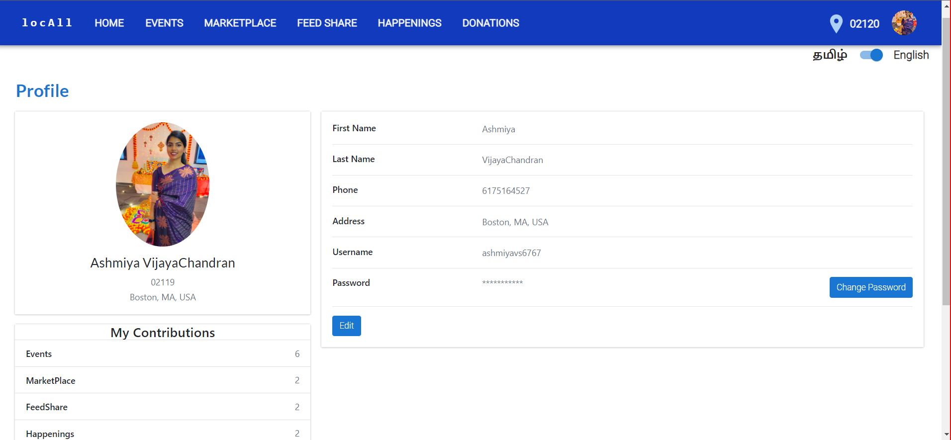
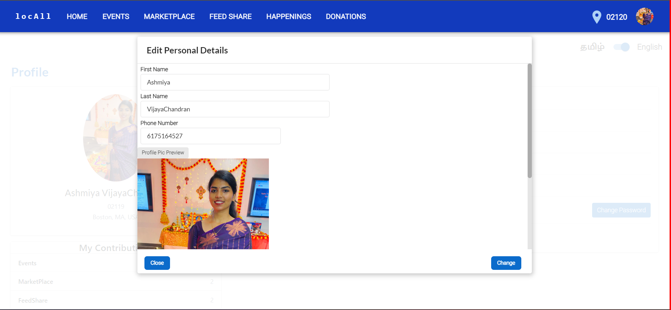
USER PROFILE

Slide 17
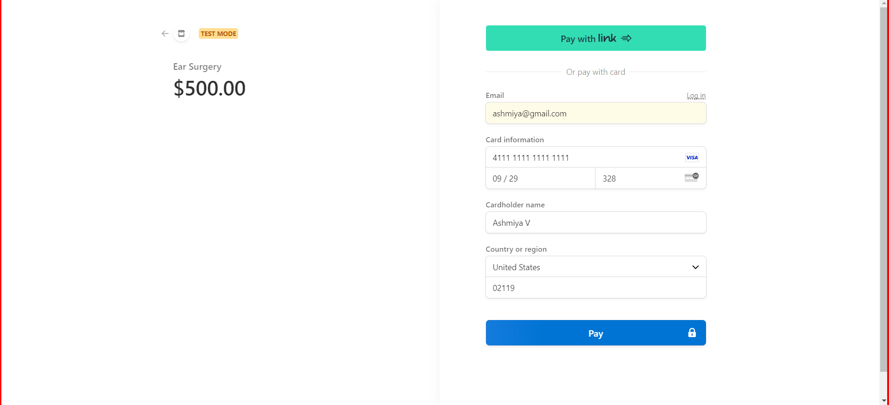
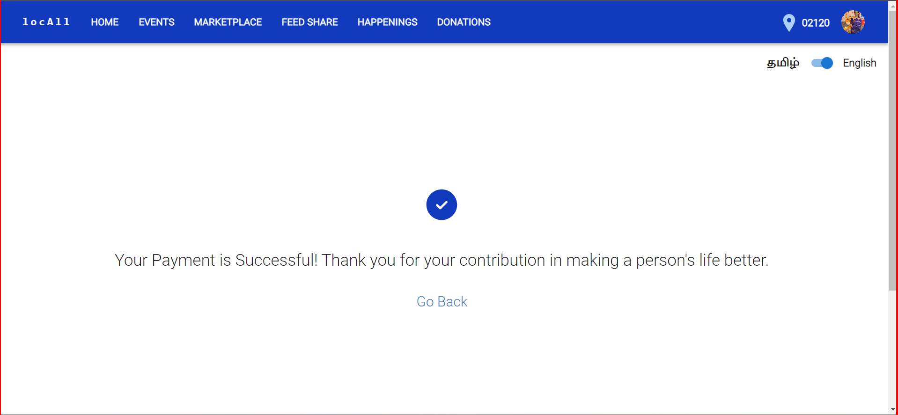
PAYMENTS

Slide 18
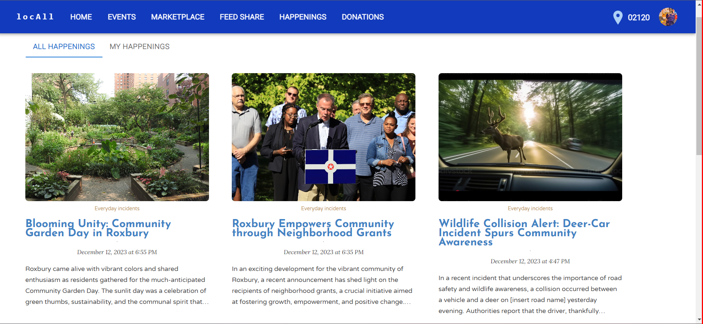
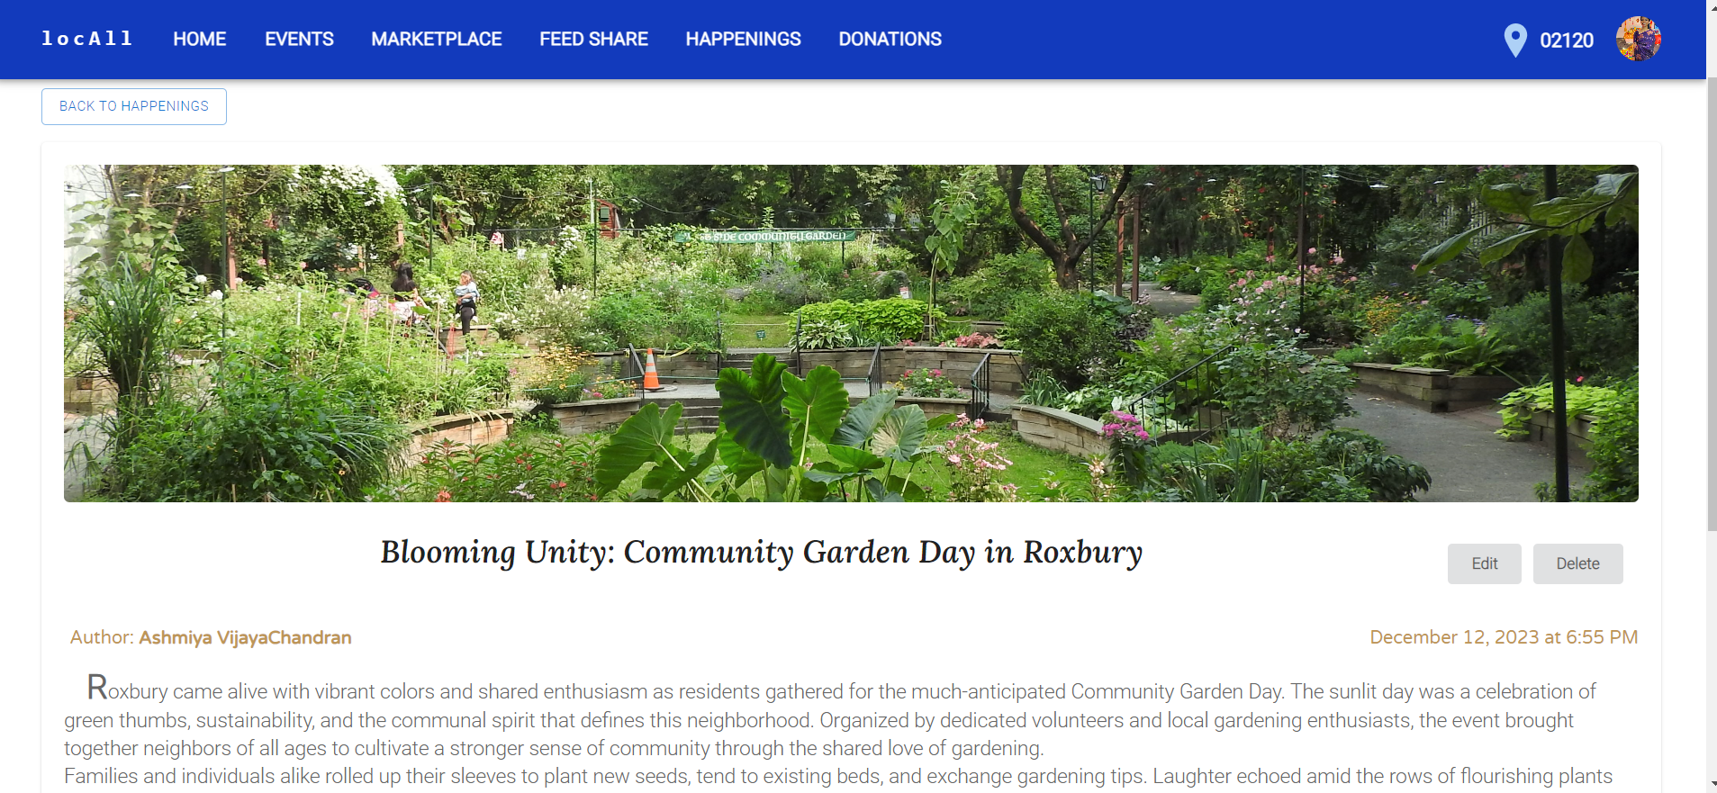
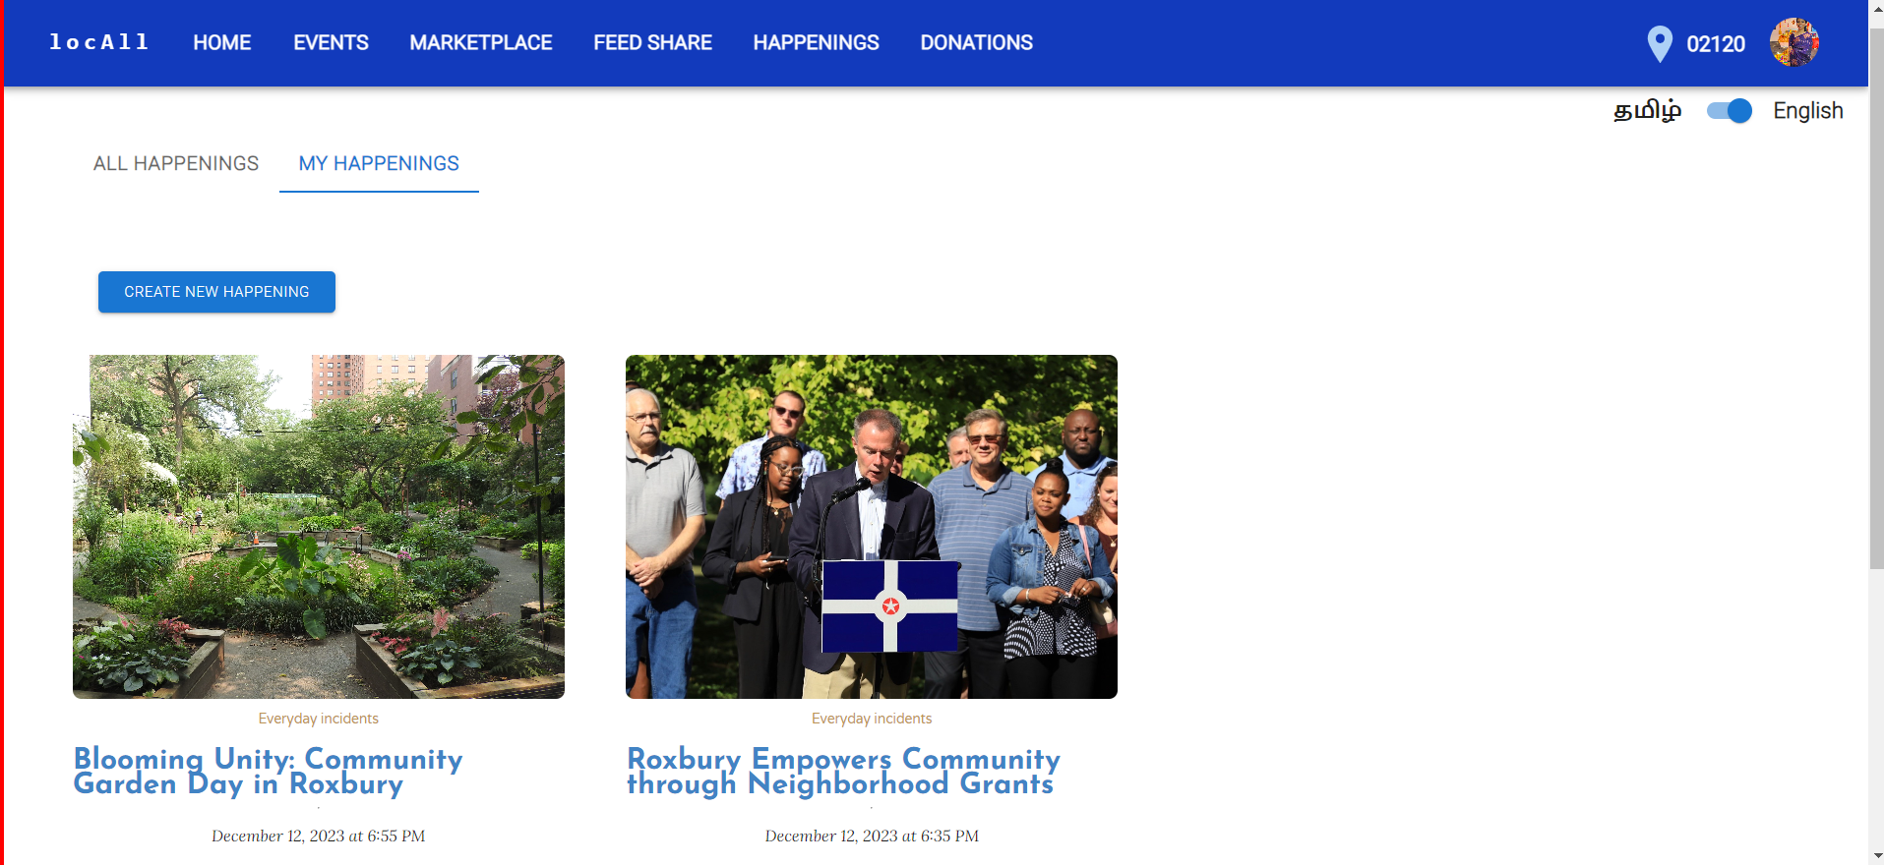
HAPPENINGS

Slide 19
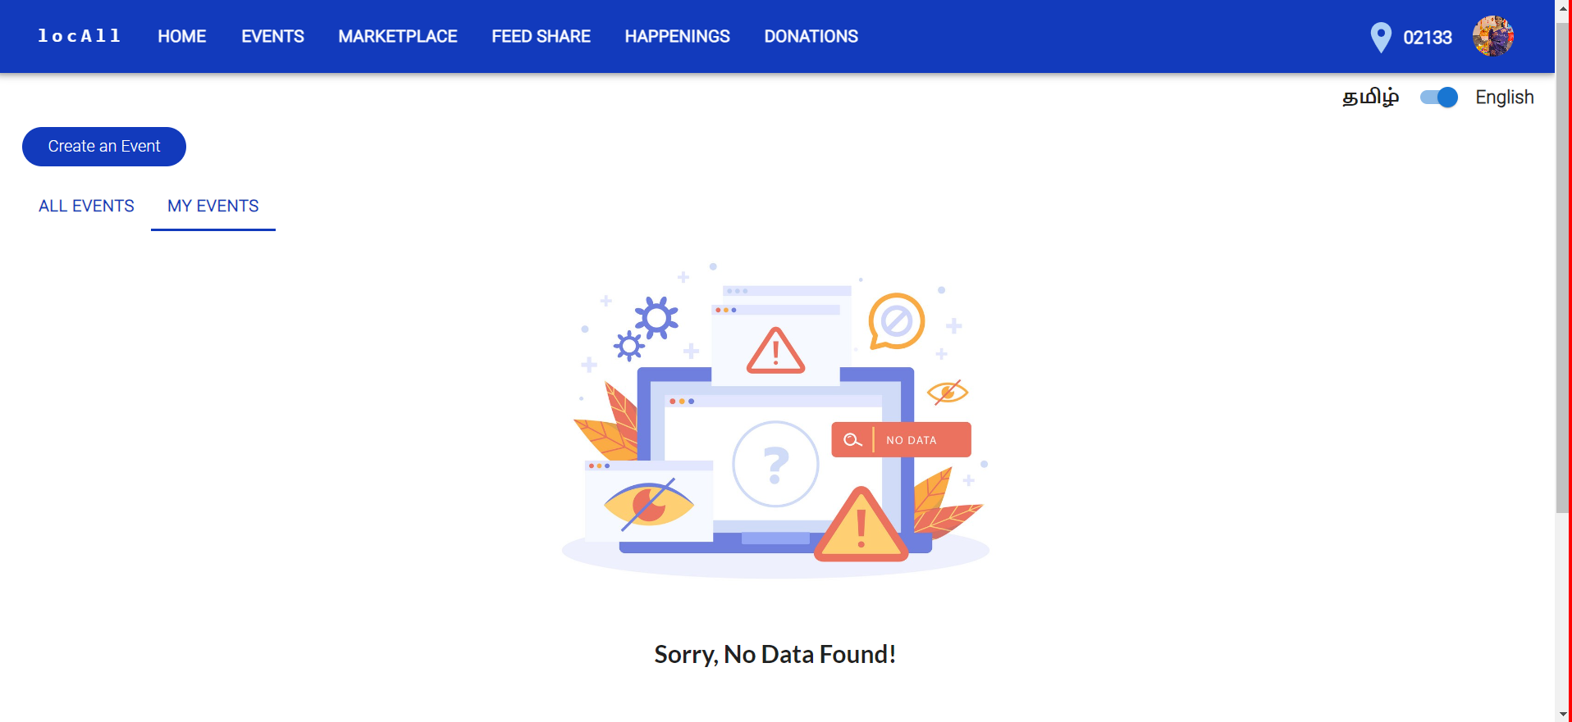
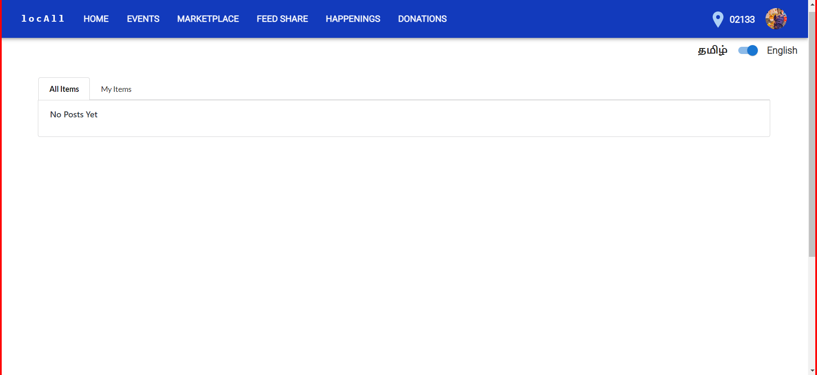
NO DATA FOUND

Slide 20
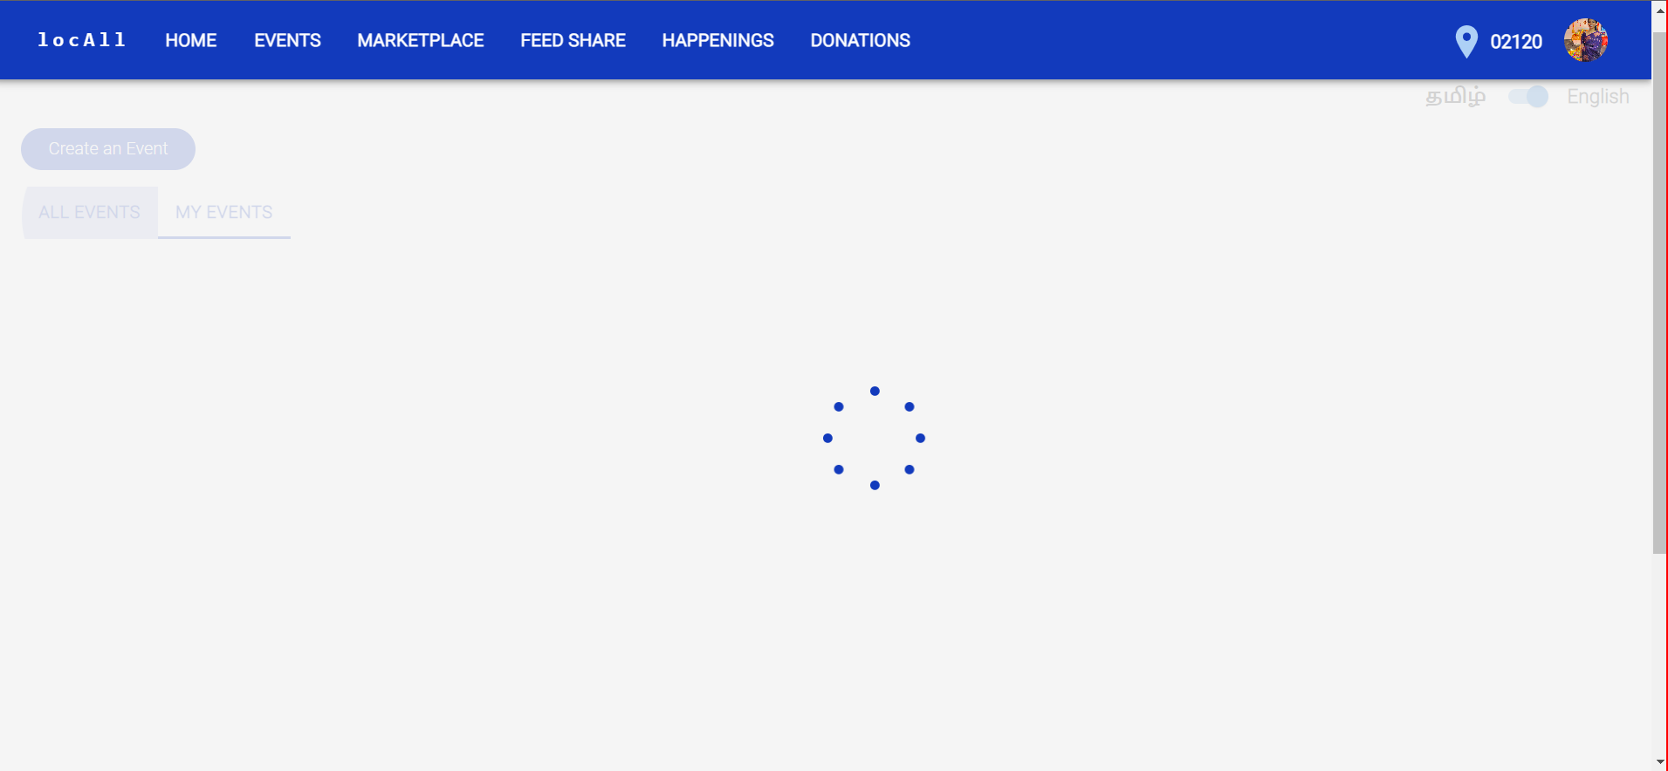
LOADING SCREEN

